Slide 1
University of Basrah
Al-Zahraa Medical College
Ministry of higher Education and Scientific Research
Academic year 2021-2022
3rd year S 5
REPRODUCTIVE SYSTEM MODULE
Session: 7
Lecture: 3
Duration : 1 hour
SUBFRTILITY
Presented by
Dr.RAYA MUSLIM AL HASSAN
Module staff:
Dr.Raya Muslim Al Hassan (module leader) Dr.Nada H Al Jassim
Dr.Alaa Hifthi Dr.Nawal Mustafa Abdulah
Dr.Marwa sadik Dr.Nehaya Mnahi Al Aubody
GYNAECOLOGY 20th
EDITION by Ten Teachers

Slide 2
What is subfertility?
University of Basrah
Al-Zahraa Medical College
Ministry of higher Education and Scientific Research
Subfertility is the failure of conception in
a couple having regular, unprotected coitus for 1 year
PRIMARY – Couple without a prior pregnancy
SECONDARY – Couple with previous pregnancy including miscarriage/ectopic
75-80% of couples there will be pregnancy after 12 cycles
90-95% of couples will be pregnant after 2-3 years.

Slide 3
University of Basrah
Al-Zahraa Medical College
Ministry of higher Education and Scientific Research
Causes :-
A - Female 30%
1- ovulatory disorders : -
The commonest cause is polycystic ovary syndrome (PCOS)
Hypothalamic disorders e.g. Hypothalamic hypogonadism) .
Pituitary disease (e.g. Hyperprolactinaemia).
Endocrine abnormalities (thyroid disease) .
2- Tubal factors :- (PID, previous surgery, endometriosis)
3- Uterine factors :- (fibroid, adhesions)
4-Peritoneal (endometriosis).
5- Cervical factors .

Slide 4
University of Basrah
Al-Zahraa Medical College
Ministry of higher Education and Scientific Research
B -Male 30%
Compromised sperm number or quality is an important contributor to subfertility. ( Mainly unknown cause ) .
- Possible causes :-
Environmental and dietary issues.
Infections :- ( Orchitis , epididymitis )
Iatrogenic :- pelvic radiotherapy or surgery for undescended or torted testes .
Medical conditions such as diabetes .
Occupational factors :- contact with chemicals , radiation or heat .
Erectile difficulties or problems with ejaculation.
Genetic : aneuploidy of sex chromosomes (Klinefelter
XXY most commonly)
C - Mixed 15%
D -Unexplained 25%

Slide 5
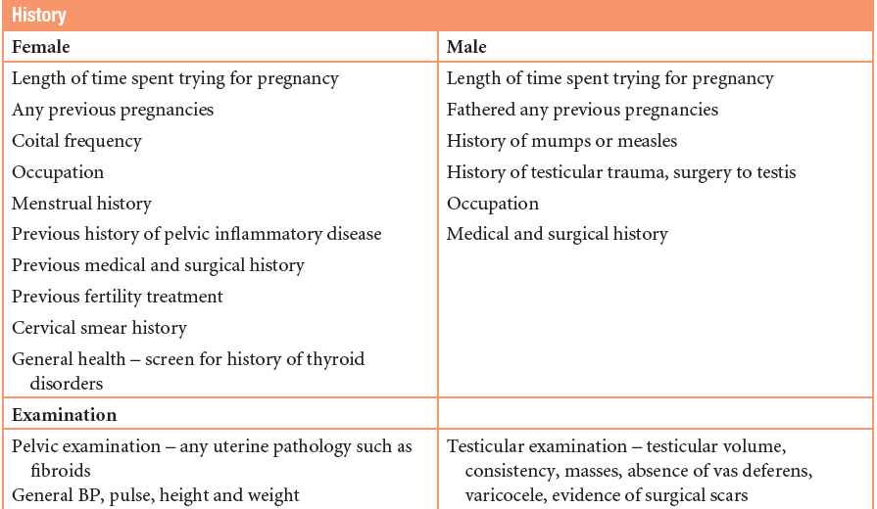
History & examination
University of Basrah
Al-Zahraa Medical College
Ministry of higher Education and Scientific Research

Slide 6
University of Basrah
Al-Zahraa Medical College
Ministry of higher Education and Scientific Research
INVESTIGATIONS
Female
Assess ovulation .
Tubal patency .
Uterine abnormality .
Male
Semen analysis .
Hormonal analysis(T, FSH, LH) +/-Karyotyping

Slide 7
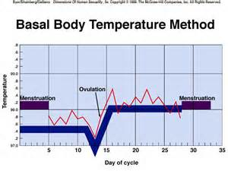
ASSESSING OVULATION
University of Basrah
Al-Zahraa Medical College
Ministry of higher Education and Scientific Research
1)History (regular cycle, dysmenorrhoea, breast engorgement)
2)Basal body temperature chart
3)Hormonal study
-Serum progesterone (mid luteal
phase ie day 21 of 28-days cycle)
- LH/FSH levels
-E2, Testosterone levels – PCOS
-Prolactin
-Thyroid tests
- Serum AMH

Slide 8
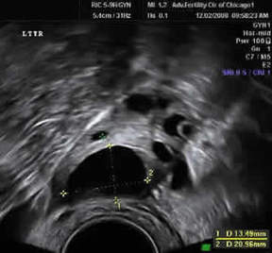
University of Basrah
Al-Zahraa Medical College
Ministry of higher Education and Scientific Research
4) Ultrasound
Assess ovulation
(by tracking the size of follicle)
U/S of the ovary at day 13 of cycle showing the pre- ovulatory dominant follicle size of 20 mm (normal 18-22 mm)

Slide 9
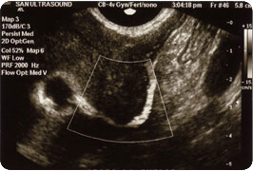
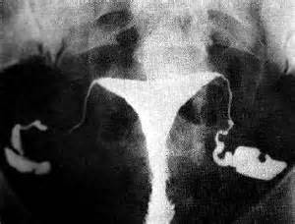
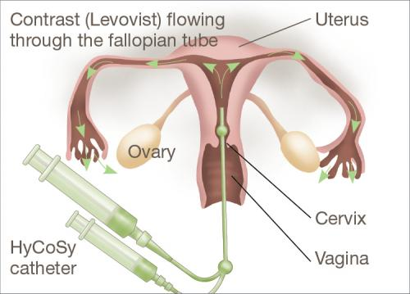
ASSESSING UTERINE/TUBAL PROBLEMS
University of Basrah
Al-Zahraa Medical College
Ministry of higher Education and Scientific Research
Hystero-Contrast -Sonography (HyCoSy)
HSG/hysterosalpingoigraphy

Slide 10
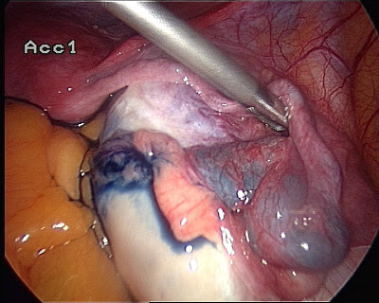
University of Basrah
Al-Zahraa Medical College
Ministry of higher Education and Scientific Research
Laparoscopy + dye test (chromotubation) if tubal blockage seen in HSG

Slide 11
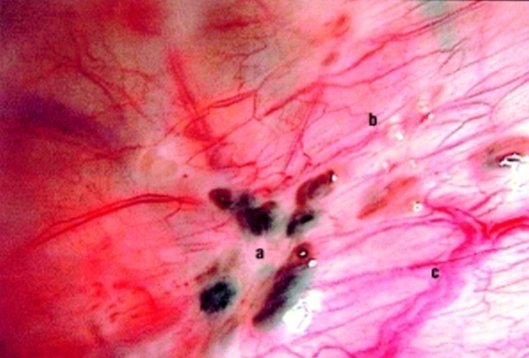
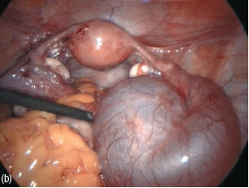
University of Basrah
Al-Zahraa Medical College
Ministry of higher Education and Scientific Research
ASSESSING PERITONEAL FACTORS
Laparoscopy
endometriosis

Slide 12
INVESTIGATIONS (MALE)
University of Basrah
Al-Zahraa Medical College
Ministry of higher Education and Scientific Research
Semen analysis
Needs prior appointment with lab
Abstinence 2-4 days.
Complete collection of the semen
Transport to lab in 1 hour
Put it in incubator 37˚c or at room temperature.

Slide 13
University of Basrah
Al-Zahraa Medical College
Ministry of higher Education and Scientific Research

Slide 14
TREATMENT
University of Basrah
Al-Zahraa Medical College
Ministry of higher Education and Scientific Research
Fertility treatment should be individualized to optimize the treatment result, Management may be expectant, medical, surgical or combination of these.

Slide 15
OVULATION INDUCTION
University of Basrah
Al-Zahraa Medical College
Ministry of higher Education and Scientific Research
1) Normogonadotrophic anovulation (PCOS).
Anti- oestrogens e.g Clomiphene/ Tamoxifen
Metformin
Gonadotrophins
2) Hypogonadotrophic hypogonadism
Pulsatile GnRH
Gonadotrophins with LH activity
Bromocriptine ( for hyperprolactinaemia)
3) Laparoscopic ovarian drilling
4) Luteal phase support-progesterone

Slide 16
Peritoneal/Uterine/tubal problems
University of Basrah
Al-Zahraa Medical College
Ministry of higher Education and Scientific Research
Endometriosis:Laparoscopic surgical ablation/ resection of spots + adhesiolysis .
Uterine factors: hysteroscopic adhesiolysis for Asherman’s syndrome ,myomectomy for fibroid .
Tubal factors: Laparoscopic tubal surgery or IVF .

Slide 17
Treatment of male subfertlity
University of Basrah
Al-Zahraa Medical College
Ministry of higher Education and Scientific Research
According to the cause
IUI ???
IVF ???

Slide 18
University of Basrah
Al-Zahraa Medical College
Ministry of higher Education and Scientific Research
Intra-uterine insemination(IUI): injection of activated semen inside the uterus by a catheter

Slide 19
University of Basrah
Al-Zahraa Medical College
Ministry of higher Education and Scientific Research
IVF

